Slide 1
2D Semantic Segmentation in SUSTech Scenes
CS405 Project
Jan 13, 2024
Haoyu Wang，
Zhangjie Chen,
Xudong Zhang,
Yuxuan Li

Slide 2

Outline
Background and Motivation
Existing Methods
System up and Problem statement
Proposed Method I and Results
Proposed Method II and Results
Comparison and Discussion
Reference

Slide 3
Part Ⅰ （Xudong Zhang）
Background and Motivation
Existing Methods

Slide 4
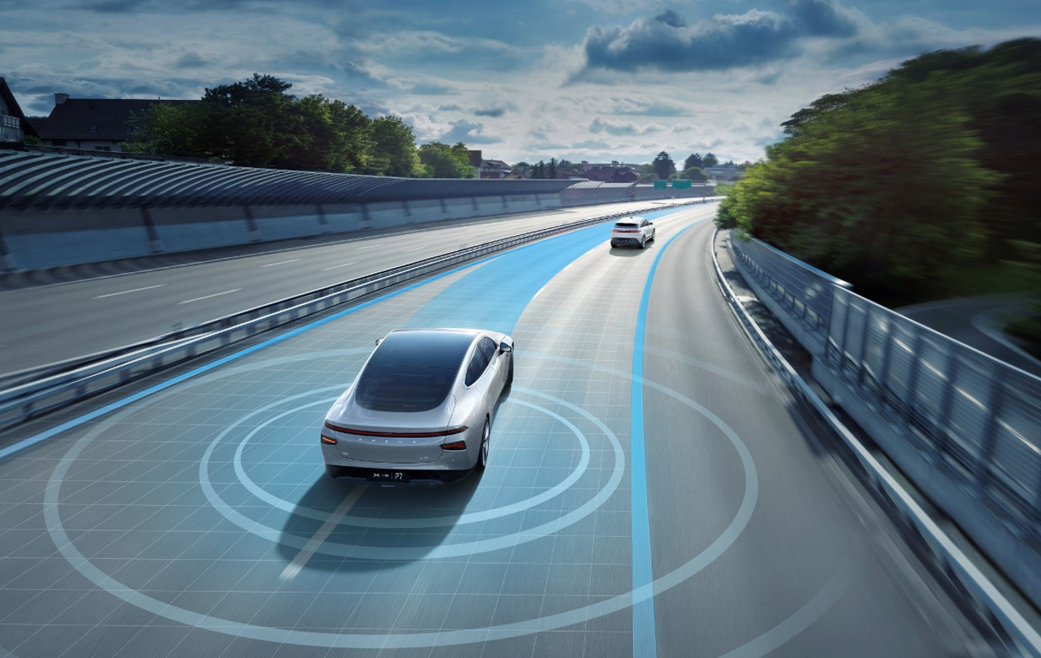
Background and Motivation
Autonomous driving
Image source: https://img.evlook.com/evlook/ueeditor/132596687582303539.jpg
Notes:
自动驾驶，也被称为自动驾驶或无人驾驶技术。自动驾驶利用传感器、摄像头、雷达和人工智能的组合来感知周围环境并做出实时决策。环境感知、数据处理、路径规划和控制系统等这些因素共同确保了自动驾驶的安全与舒适。其中，环境感知是自动驾驶的关键功能，它关注的是车辆解读和理解周围环境的能力。但现实环境中不可预测的路况和动态场景等这些不确定因素给自动驾驶带来了极大的挑战。语义分割是解决这个挑战的其中一种方法。

Slide 5
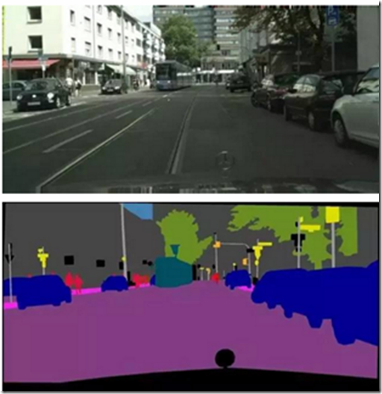
Background and Motivation
Semantic Segmentation
Pixel-level Classification
Wide applications
autonomous driving
medical imaging
robotic vision
video surveillance
Deep learning Approaches
U-Net, DeepLab,…
Image source: https://images2015.cnblogs.com/blog/1139079/201706/1139079-20170621162947788-42799910.png
Notes:
语义分割旨在将数字图像分割成若干个语义区域。在语义分割任务中，每个像素都被分配一个类别标签，使得具有相同类别的像素被归为同一区域。这些类别通常是有意义的物体或场景的一部分，如人、车辆、建筑物、树木等。它的应用非常广泛，包括上文提到的自动驾驶领域以及 医疗影像中对于病变区域的识别、机器人视觉任务中机器人对于周围环境的理解 和 通过监控视频对人群进行识别和分析。

Slide 6
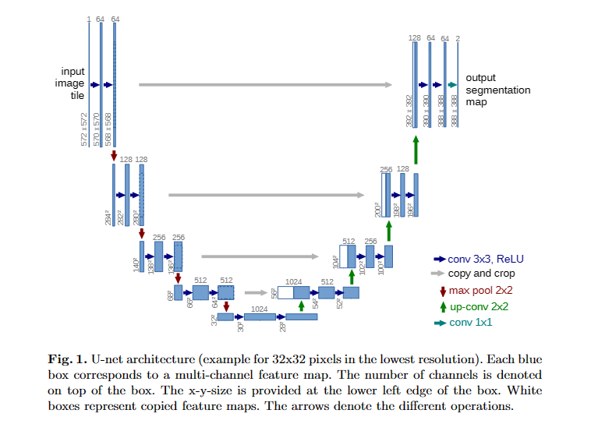
Existing Methods
U-net
contracting path => expansive path
Advantages
U-shape: preserve high-resolution features
Skip connections: Retain details
Multiresolution feature
Superior performance on small sample data
Disadvantages
Large computing and storage resources on large size image
High dependence on datasets and large requirement on labeled data for training
Notes:
U-Net是比较早的使用全卷积网络进行语义分割的算法之一，它希望能够识别图片中的细胞边界。他的创新性在于压缩路径和扩展路径，两个路径分别进行最大池降采样操作和反卷积，最终得到一个2维的segmentation map。U-Net的U型结构有助于保留高分辨率特征，还使用了跳跃连接，可以更好地保留细节信息，他在小样本上表现优越。但他也有一定缺点：unet神经网络在处理大尺寸图像时，需要较大的计算和存储资源。unet神经网络对数据集的依赖性较强，需要大量的标注数据进行训练。

Slide 7
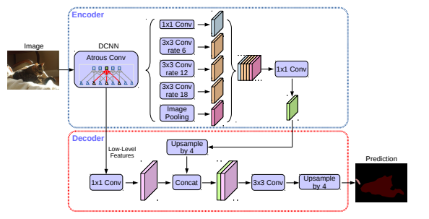
Existing Methods
DeepLabv3+
Atrous Convolution
Advantages
Spatial pyramid pooling
Depthwise Separable Convolution
Decoder module
Disadvantages
More computing resources because of multi-scale information and decoder modules
Notes:
DeepLabv3+是另外一种用的比较多的语义分割神经网络。它采用了空洞卷积，允许网络在感受野内引入多尺度信息，提高语义分割的准确性。它还引入了空间金字塔池化，使网络能够对不同尺度的特征进行有效的建模，增强对物体边界和细节的识别能力，使用深度可分离卷积来减少参数量，提高计算效率，特别适用于移动设备等资源受限环境。引入了解码器模块，结合高分辨率特征，有助于更好地还原语义分割结果，提高分割效果。此外，它有一定的缺点：由于引入了多尺度信息和解码器模块，DeepLabv3+的计算复杂度相对较高，可能需要更多的计算资源。

Slide 8
Part Ⅱ （Haoyu Wang）
System Setup and Problem Statement

Slide 9
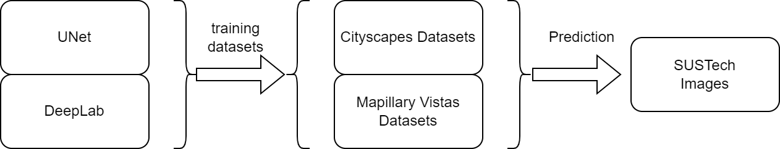
System Setup and Problem Statement
System:
Two models
Two training datasets
Manually annotated photos of SUSTech
Notes:
没办法使用SUSTech标注好的的语义分割数据集；人工标注需要花费大量时间

Slide 10
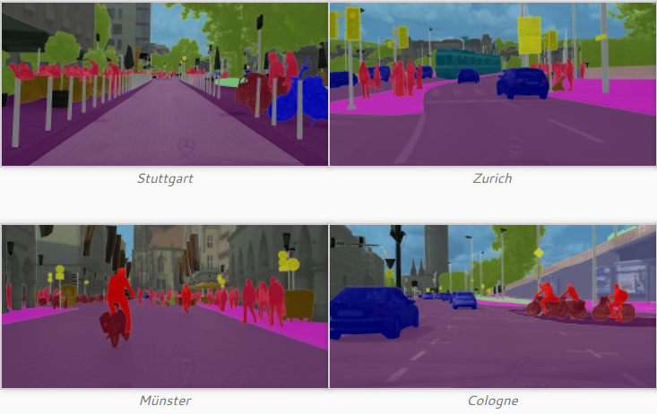
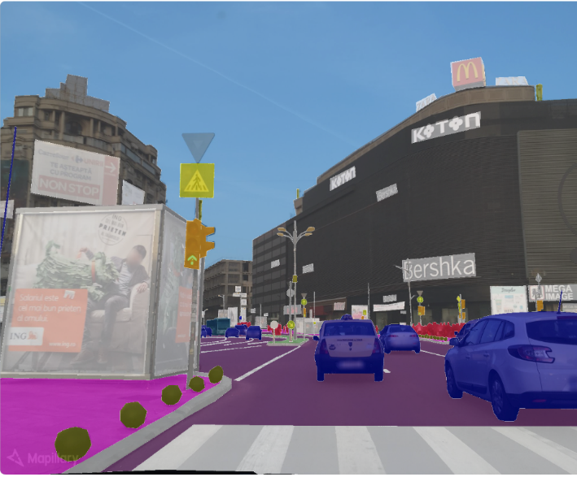
System Setup and Problem Statement
Dataset
Cityscapes Dataset
https://www.cityscapes-dataset.com/
The Cityscapes Dataset focuses on semantic understanding of urban street scenes
Train/Test set: leftImg8bit_trainvaltest & gtFine_trainvaltest
Mapillary Vistas Dataset v1.2
https://www.mapillary.com/dataset/vistas
A diverse street-level imagery dataset with pixel‑accurate and instance‑specific human annotations for understanding street scenes around the world.
18000+ high-resolution images
60+ semantic object categories

Slide 11
Part Ⅲ （Zhangjie Chen）
Proposed Method I and Results

Slide 12
Proposed Method I
Our U-Net Model
Down Sampling Layers & Pooling Layers
Input Image
Down1
pool1
Down2
pool2
Down3
pool3
Down4
pool4
Activation function: LeakyReLU
Bridge/Bottleneck
Bottleneck: capturing the most essential features while reducing its spatial dimension
Up4
Up3
Up2
Up1
Input Image
trans4
trans3
trans2
trans1
Up Sampling Layers & Transforming Layers

Slide 13
Proposed Method I
Dataset
Cityscapes Dataset
https://www.cityscapes-dataset.com/
The Cityscapes Dataset focuses on semantic understanding of urban street scenes
Train/Test set: leftImg8bit_trainvaltest & gtFine_trainvaltest
Mapillary Vistas Dataset v1.2
https://www.mapillary.com/dataset/vistas
A diverse street-level imagery dataset with pixel‑accurate and instance‑specific human annotations for understanding street scenes around the world.
18000+ high-resolution images
60+ semantic object categories

Slide 14
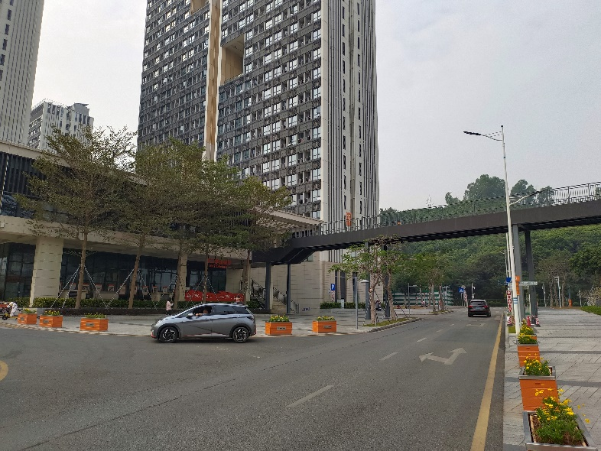
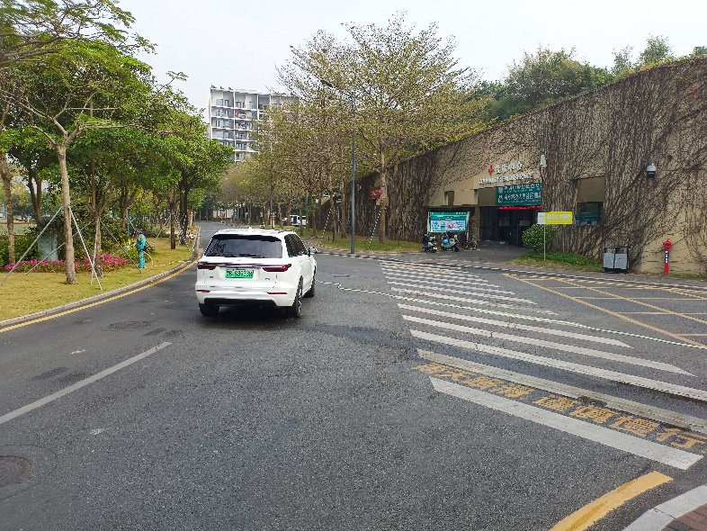
Proposed Method I
Dataset
Self-sampled SUSTech Dataset
30+ high resolution images
Pixel-level segmented with LableMe
Used for model evaluation

Slide 15
Proposed Method I
Model Training
Cityscapes Dataset (2993 training instances)
Parameters | Explanation | Value
batch_size | Train batch size(Modified according to different GPU) | 4
epoch | Number of epochs during training | 100
lr | Learning rate | 0.0002
img_size | Size of image (resized) in training and evaluating | 128*256
Mapillary Dataset (18000 training instances)
Parameters | Explanation | Value
batch_size | Train batch size(Modified according to different GPU) | 4
epoch | Number of epochs during training | 50
lr | Learning rate | 0.0001
img_size | Size of image (resized) in training and evaluating | 128*256

Slide 16
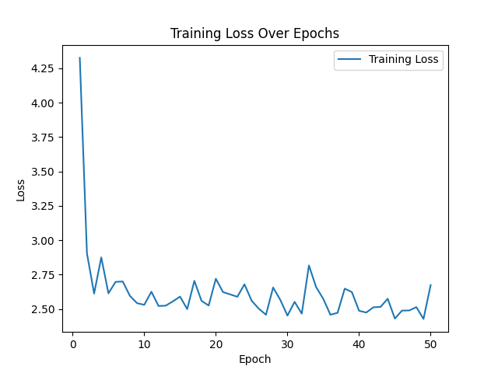
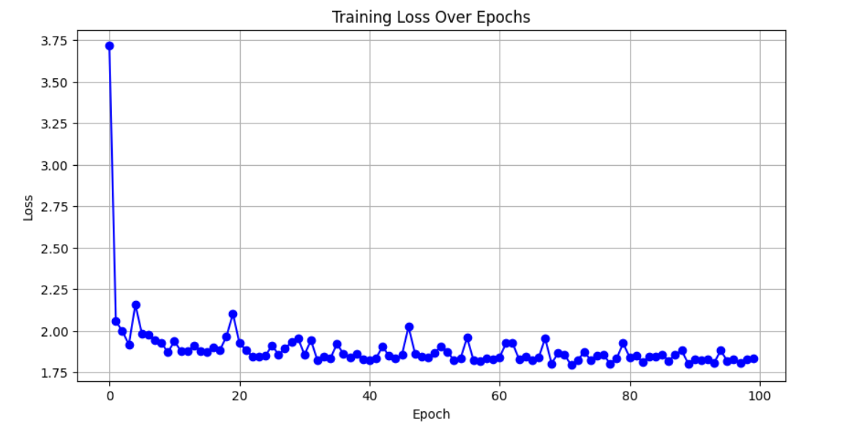
Proposed Method I
Training Result
Cityscapes Dataset
Mapillary Dataset

Slide 17
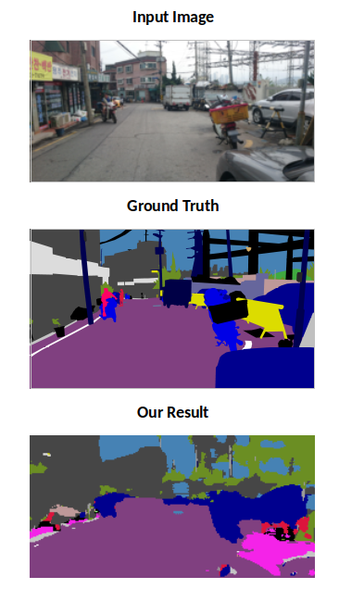
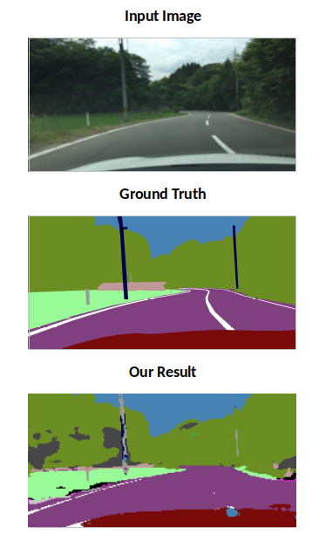
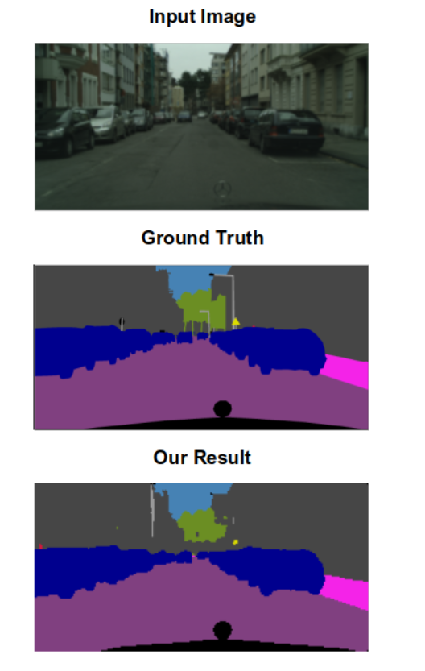
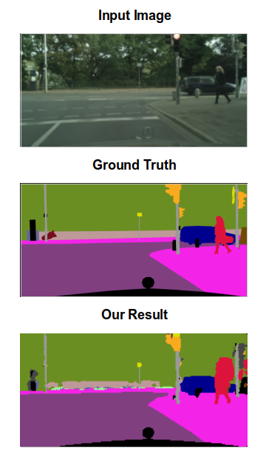
Proposed Method I
Model Performance
Cityscapes Dataset
Mapillary Dataset

Slide 18
Proposed Method I
Model Performance
Cityscapes Dataset
Pixel-Level Accuracy: 0.8443
Mapillary Dataset
Pixel-Level Accuracy: 0.7498
Label ID | Object Type | IoU
1 | ego vehicle | 0.8170
7 | road | 0.8951
11 | building | 0.7786
20 | traffic sign | 0.3951
21 | vegetation | 0.8210
23 | sky | 0.8090
24 | person | 0.4578
Label ID | Object Type | IoU
13 | road | 0.6534
17 | building | 0.5586
19 | person | 0.0805
27 | sky | 0.9142
30 | vegetation | 0.6613
55 | car | 0.5186
64 | ego vehicle | 0.5917

Slide 19
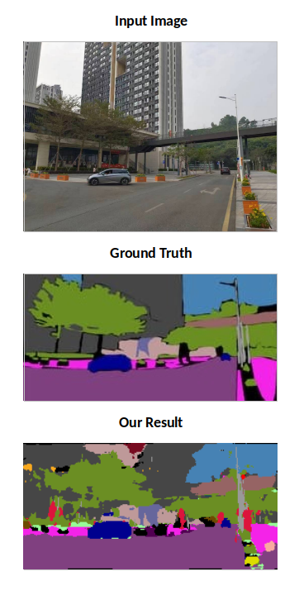
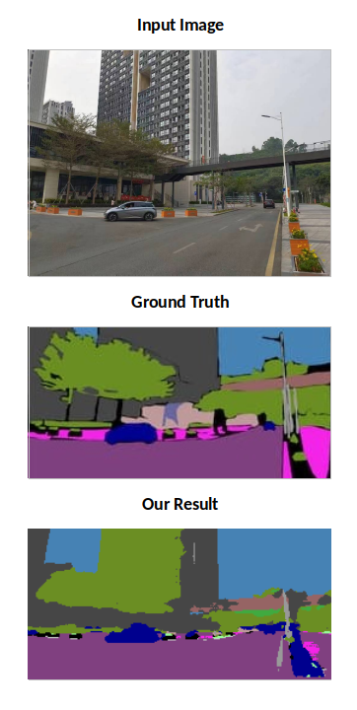
Proposed Method I
Model Performance on SUSTech Dataset
Cityscapes Dataset
Cityscapes Dataset
Pixel-Level Accuracy: 0.6207
Mapillary Dataset
Pixel-Level Accuracy: 0.7144

Slide 20
Proposed Method I
Summary
Both models:
High efficiency
High IoU over dominant classes
Lower IoU over less dominant classes
The first model is more stable for street view semantic segmentation.
The second model is better at segmenting more complicated street view.

Slide 21
Part IV （Yuxuan Li）
Proposed Method II and Results

Slide 22
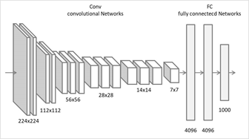
Proposed Method II
DeepLab
DeepLab v1: VGG16
Remove the pooling layer
Atrous convolution
Notes:
首先，去掉了最后的全连接层。做语义分割使用全卷积网络是大势所趋
去掉了最后两个池化层，传统（早期）DCNN，主要用来解决图片的分类问题。卷积本身就具有平移不变性，而pooling可以进一步增强网络的这一特性，语义分割是一个end-to-end的问题，需要对每个像素进行精确的分类，对像素的位置很敏感，pooling是一个不断丢失位置信息的过程。去了两个pooling，感受野又不够了怎么办？没关系，大神想了个办法，把atrous convolution借来用一下，这也是对VGG16的最后一个修改。atrous convolution人称空洞卷积（好像多称为dilation convolution，不过这是DeepLab的总结，那就得按DeepLab的来啊），相比于传统卷积，可以在不增加计算量的情况下扩大感受野

Slide 23
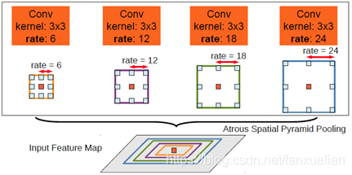
Proposed Method II
DeepLab
DeepLab v2: ResNet-101
ASPP
Notes:
可能是觉得VGG16表达能力有限，于是大神换用了更复杂，表达能力更强的ResNet-101，同样对ResNet动了刀，刀法和V1相同。V2的贡献在于更加灵活的使用了atrous convolution，提出了空洞空间金字塔池化ASPP。还是先给图。
空洞空间金字塔池化ASPP，看图就能轻易理解ASPP作用，说白了就是利用空洞卷积的优势，从不同的尺度上提取特征。这么做的原因也很简单，因为相同的事物在同一张图或不同图像中存在尺度上的差异。

Slide 24
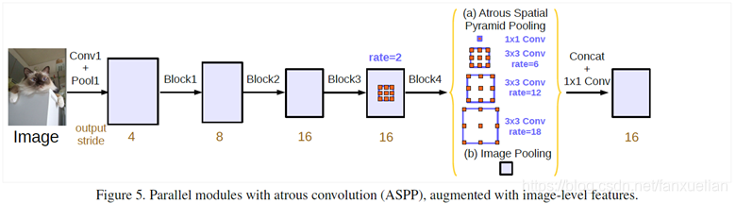
Proposed Method II
DeepLab
DeepLab v3: ResNet-101
Remove CRF
ASPP
Going deeper with atrous convolution
Notes:
舍弃了CRF，因为分类结果精度已经提高到不需要CRF了（也可能是CRF不起作用了，谁知道呢）。
对于ASPP，大神在V3中做了两点改进。一是在空洞卷积之后使用batch normalization，大神说BN对训练很有帮助。理由嘛，没有。第二点是增加了1*1卷积分支和image pooling分支。增加这两个分支是为了解决使用空洞卷积带来的问题，随着rate的增大，一次空洞卷积覆盖到的有效像素（特征层本身的像素，相应的补零像素为非有效像素）会逐渐减小到1（这里没有图全靠脑补）。这就与我们的初衷（获取更大范围的特征）相背离了。所以为了解决这个问题，一是使用1*1的卷积，也就是当rate增大以后3*3卷积的退化形式，替代3*3卷积，减少参数个数；另一点就是增加image pooling，可以叫做全局池化，来补充全局特征。具体做法是对每一个通道的像素取平均，之后再上采样到原来的分辨率。
简单说说另一种思路Going deeper with atrous convolution。为什么要加深网络呢，我理解的是为了获取更大的感受野。提到感受野自然离不开空洞卷积。还是看图说话，很显然pooling用多了特征层都快小的看不见了，所以大神给出了使用空洞卷积不断加深网络的一种思路。
DeepLab V3+再次修改了主网络，将ResNet-101升级到了Xception。在原始的Xception的基础上，大神进行了三点修改：1）使用更深的网络；2）将所有的卷积层和池化层用深度分离卷积Depthwise separable convolution进行替代，也就是下图中的Sep Conv；3）在每一次3*3 depthwise convolution之后使用BN和ReLU。
因为V3+使用深度分离卷积替代了pooling，那么为了缩小特征层尺寸，有几个block的最后一层的stride就必须为2，也就是下图中标红的层。具体有几个取决于输出output stride（下采样的大小）的设置。

Slide 25
Results
DeepLab
Epoch: 20
Batch_size: 8
Learning rate: 1x10-3
Train:
accuracy: 0.739
IoU (Intersection over Union): 0.378-0.814
High IoU over dominant classes
Lower IoU over less dominant classes

Slide 26
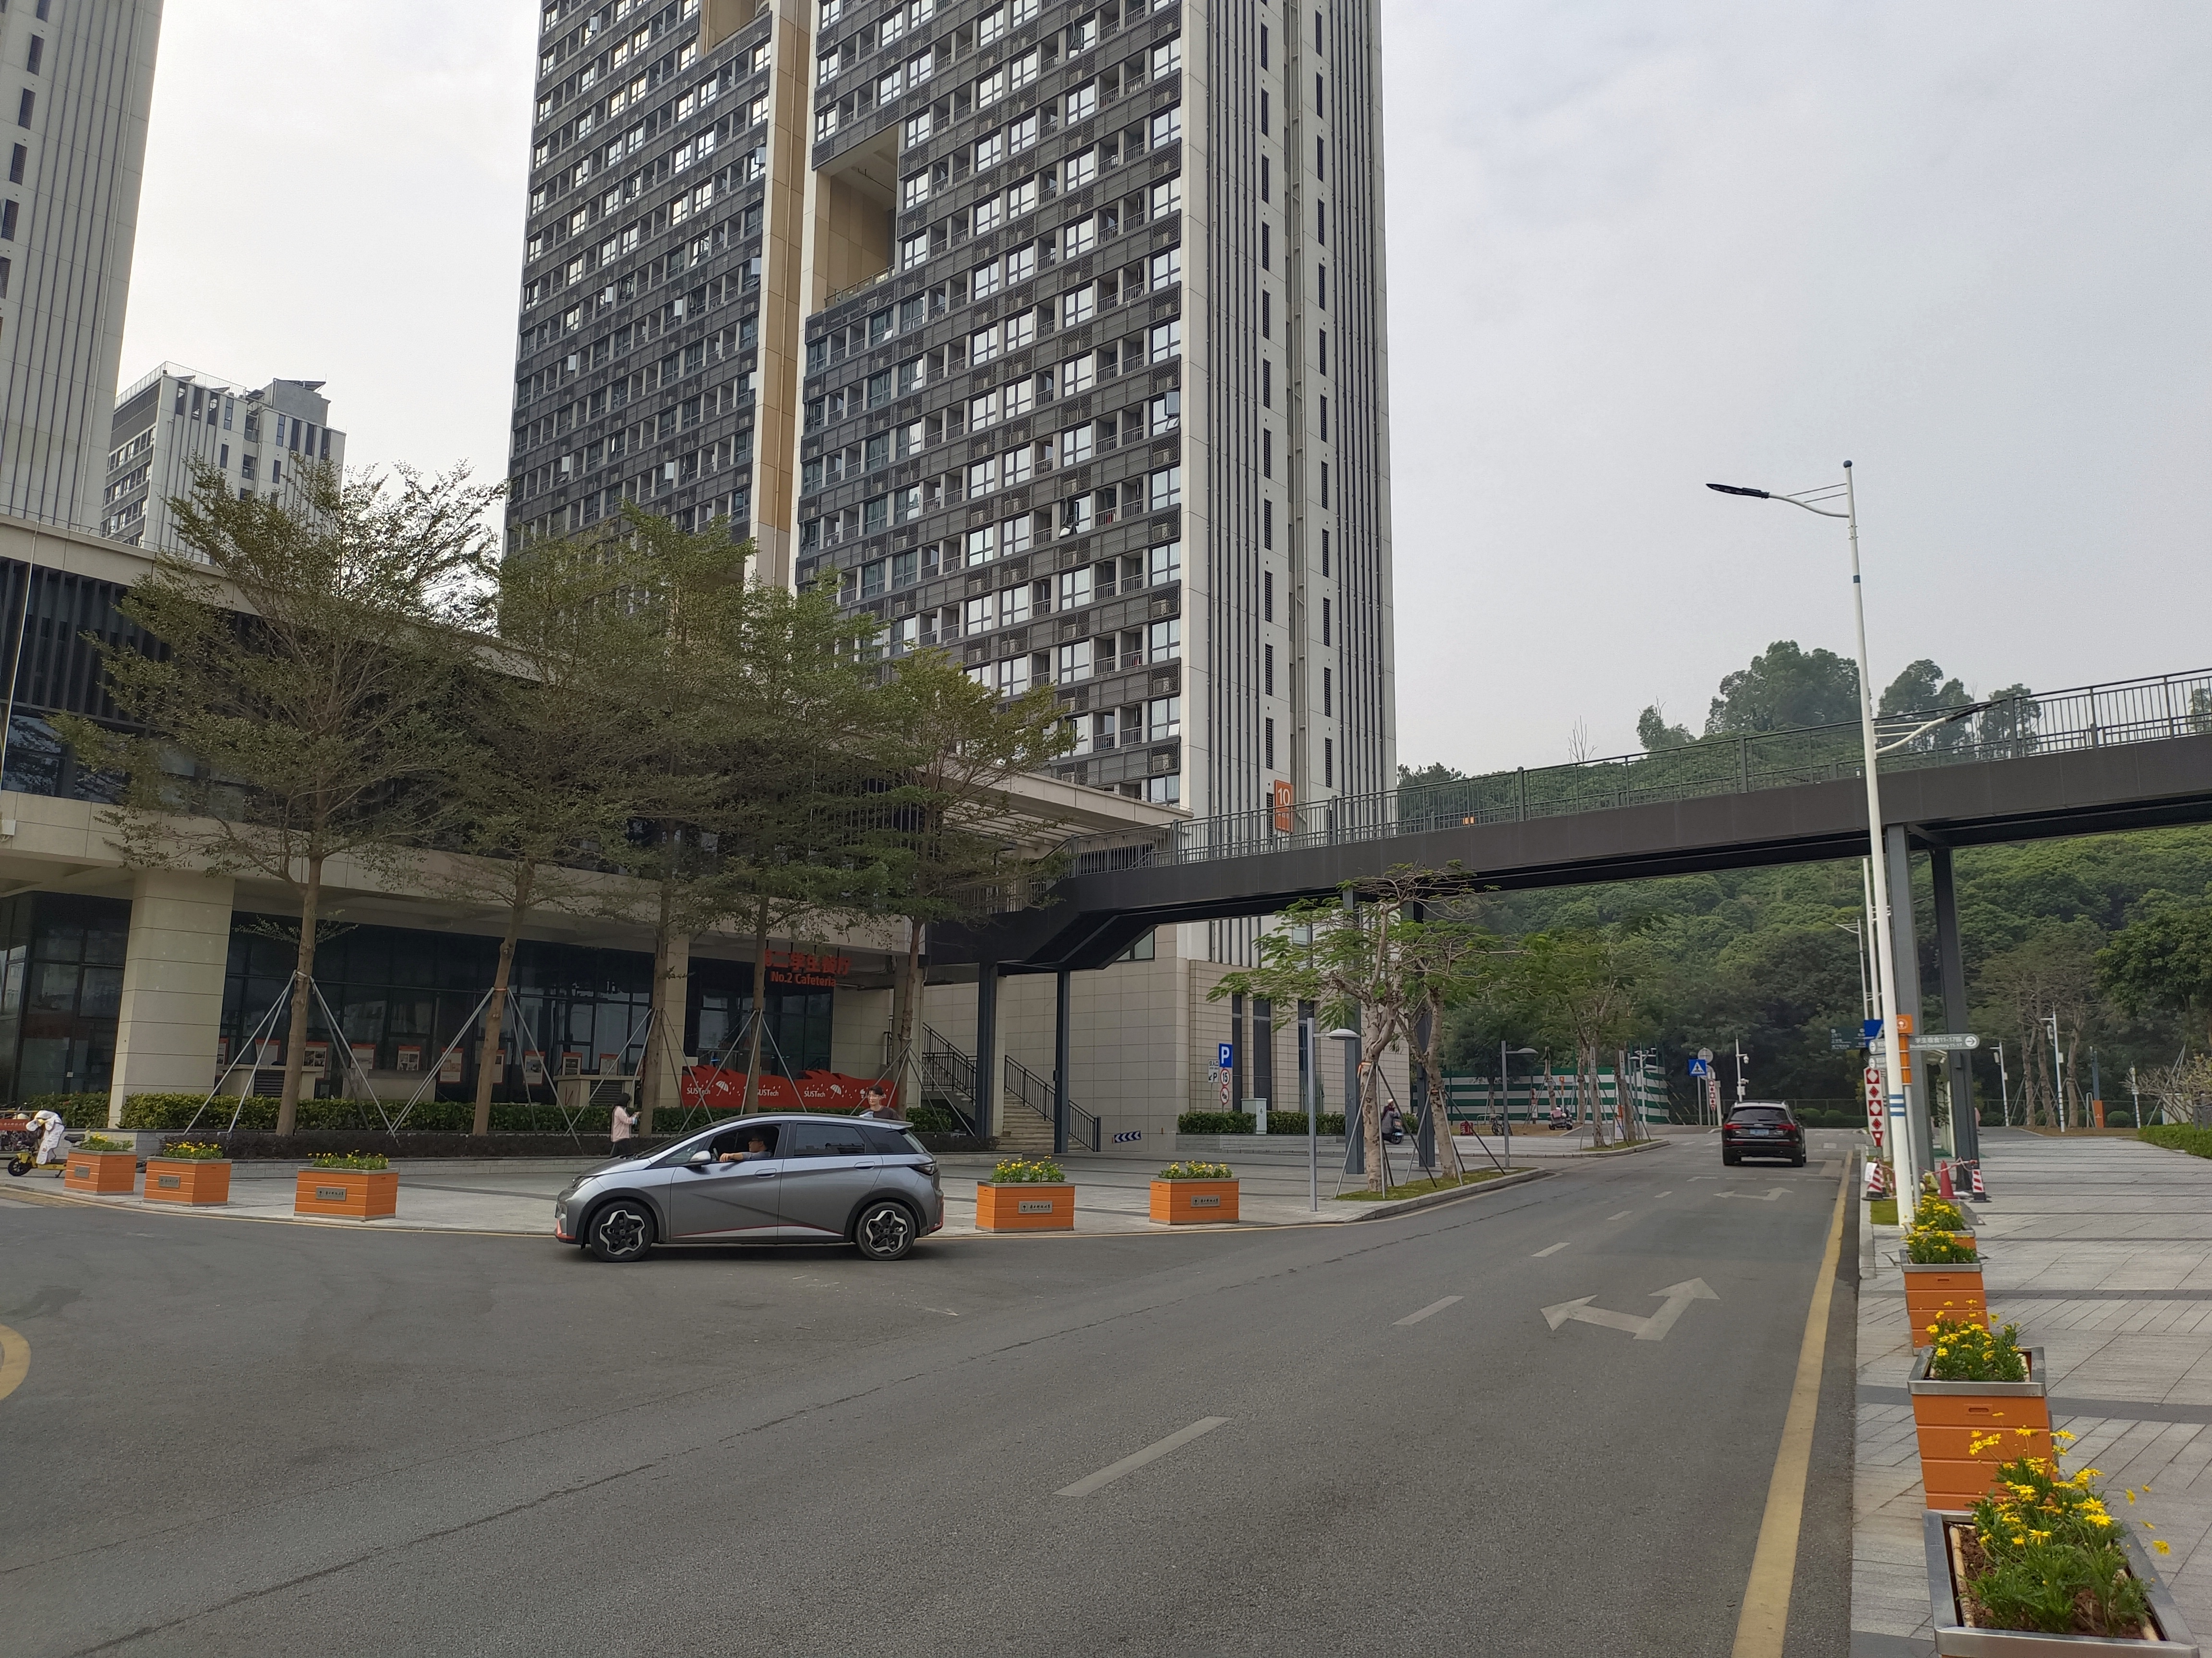
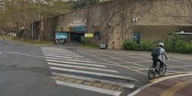
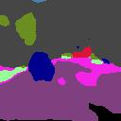
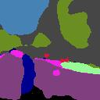
Results
SUSTech Dataset
1 GPU NVIDIA GeForce GTX 1650
Class map to save resource
Less training data

Slide 27
Part V （Haoyu Wang）
Comparison and Discussion

Slide 28

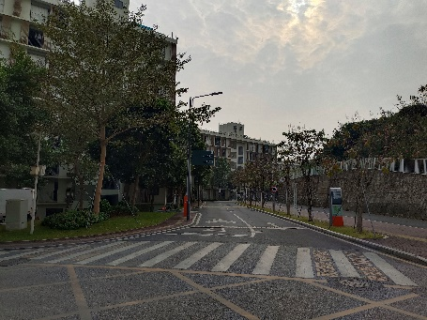
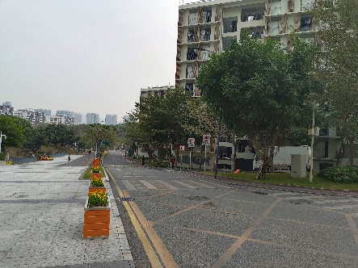
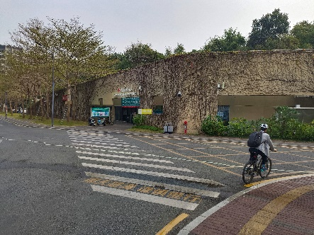
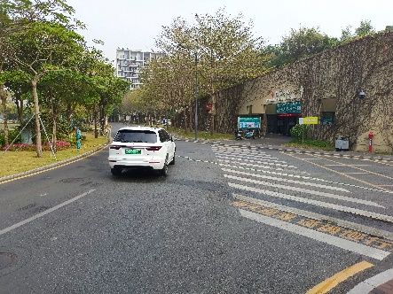
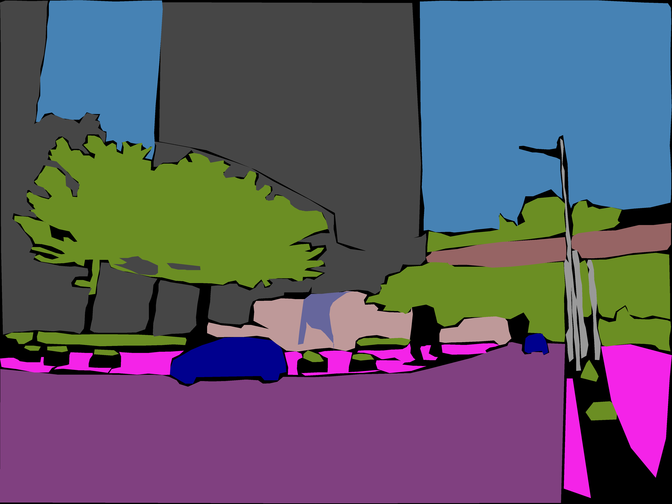
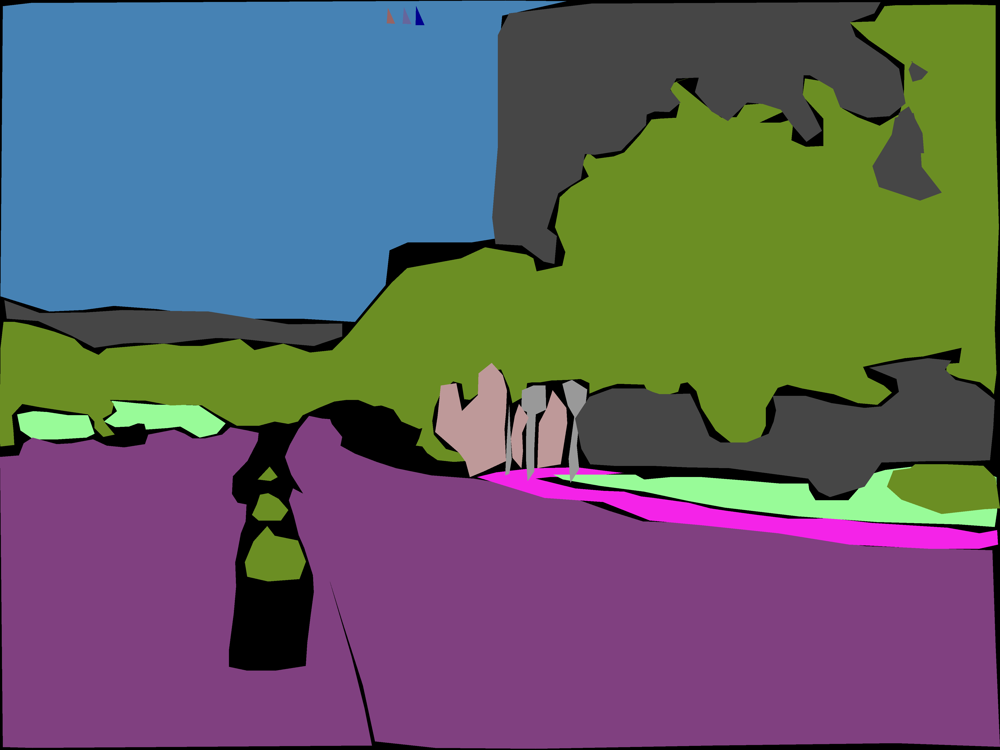
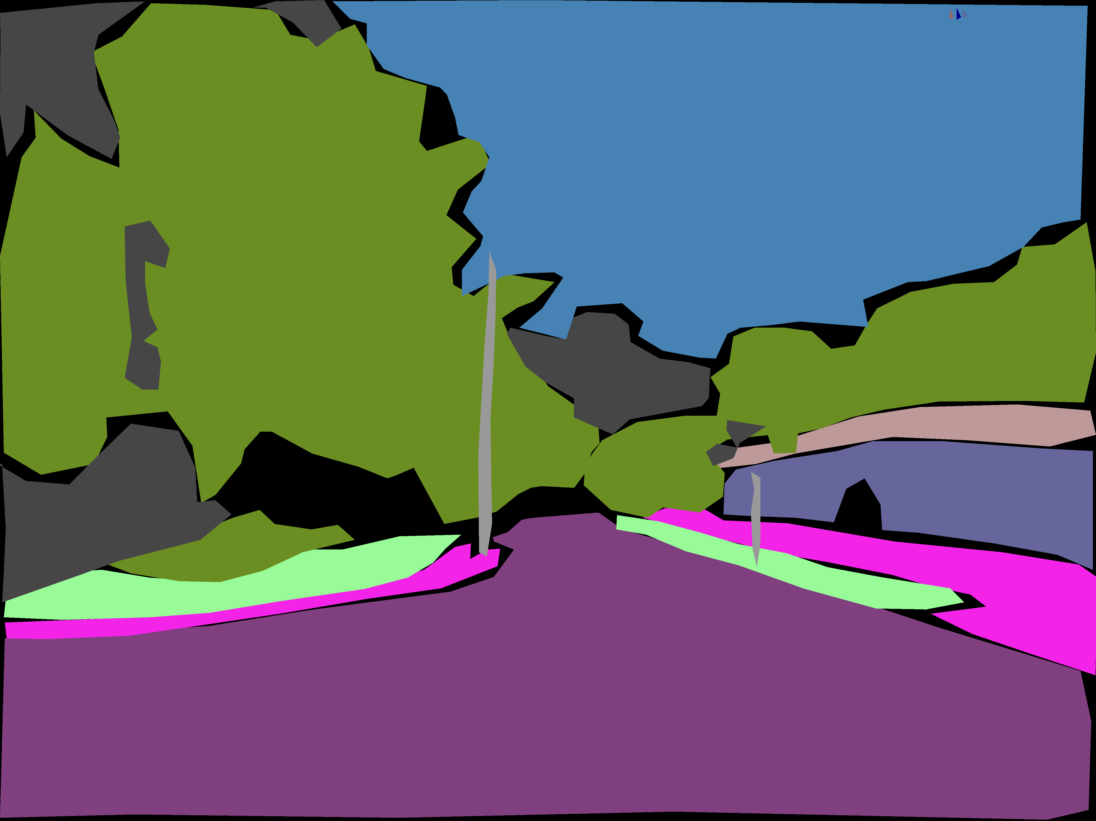
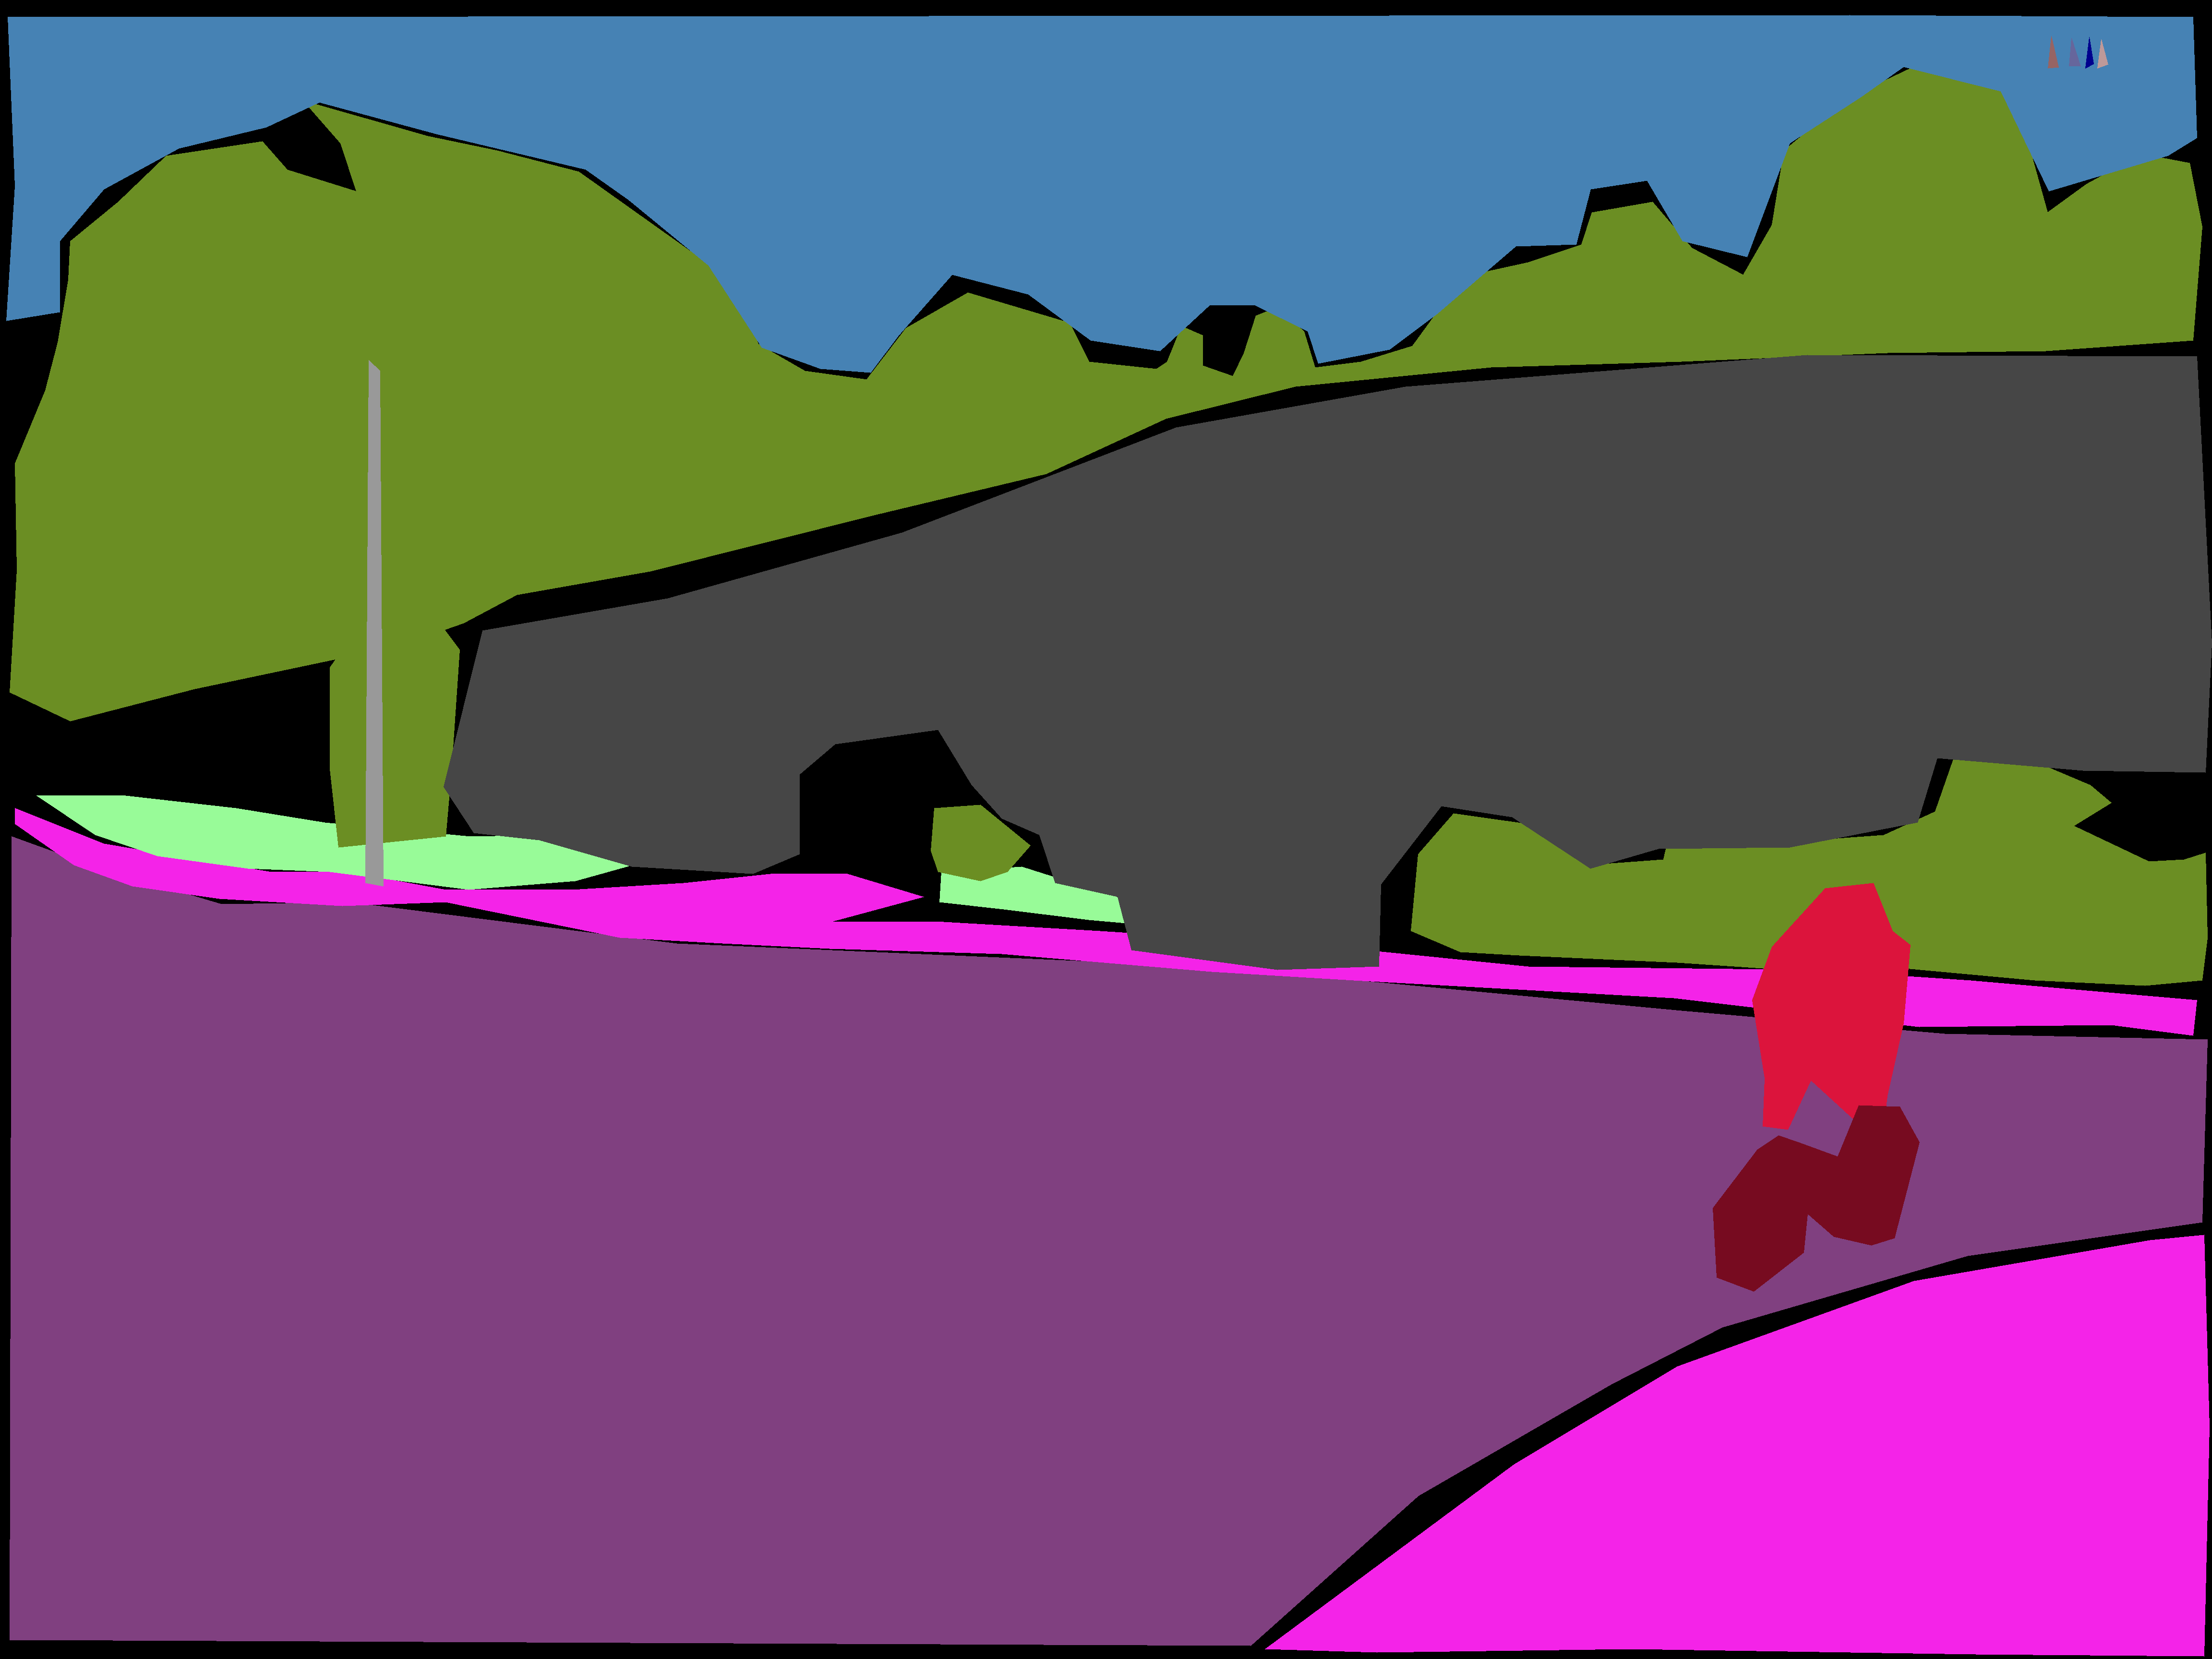
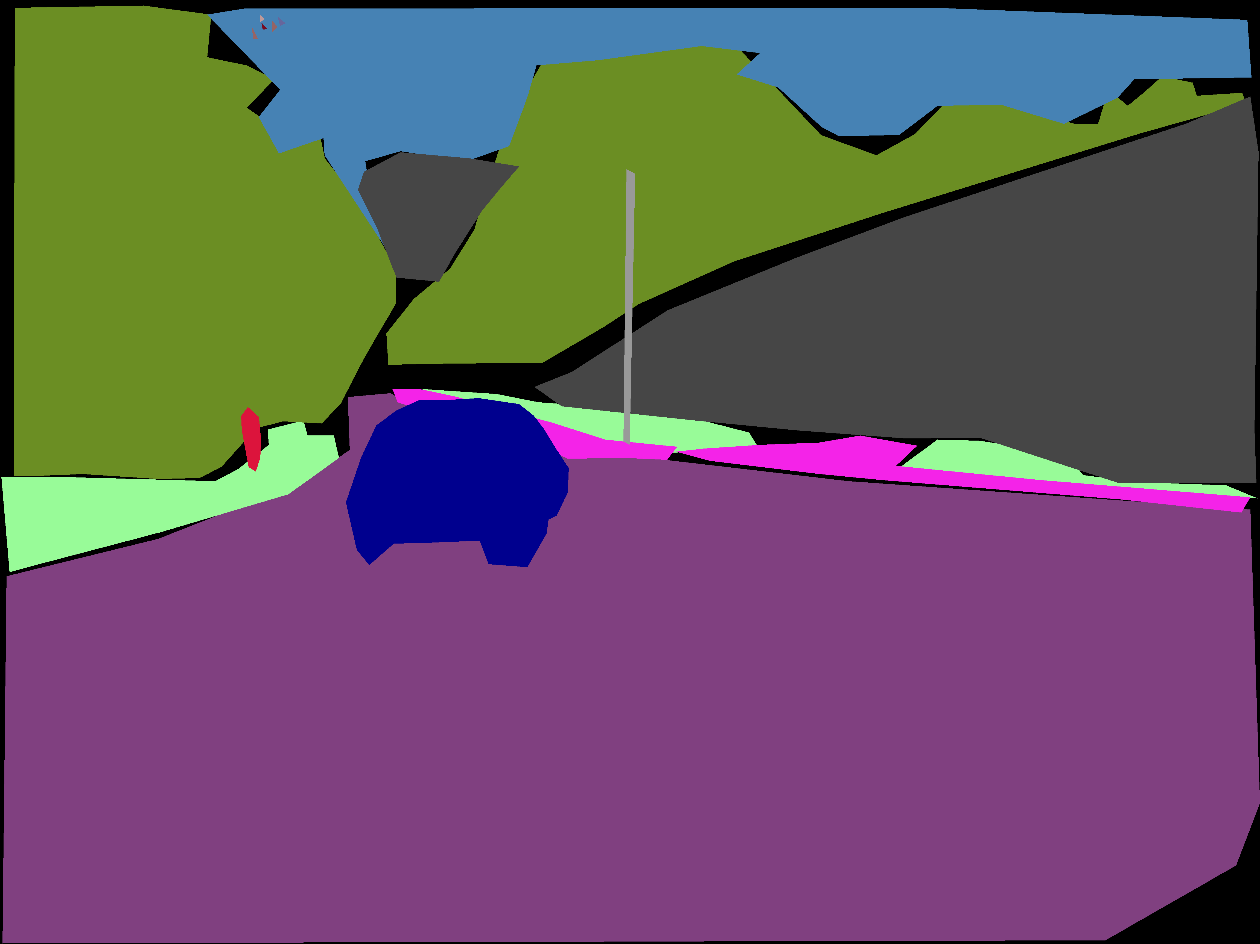
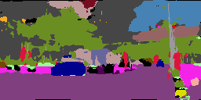
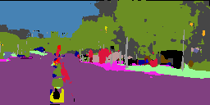
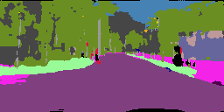
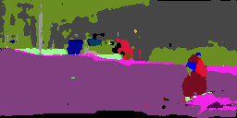
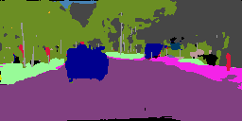
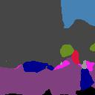
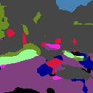
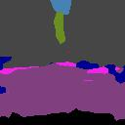
Origin
Ground Truth
Unet
Deeplab

Slide 29
Contribution
Haoyu Wang：
Survey on 2D semantic segmentation
Construct cityscapes dataset
Zhangjie Chen:
Train the U-Net model on two datasets
Conduct evaluations on trained models
Improve model performance
Xudong Zhang:
Choose model and estimate memory consumption
Evaluate test performance
Improve model performance
Yuxuan Li:
Construct self-sampled SUSTech dataset
Data preprocessing for SUSTech dataset
Improve model performance

Slide 30
Reference
[1] Olaf Ronneberger, Philipp Fisher and M. Kozubek. U-Net: Convolutional Networks for Biomedical Image Segmentation[J] .arXiv e-prints arXiv:1505.04597,2015.
[2] Prannay Khosla, Piotr Teterwak and Chen Wang. Supervised Contrastive Learning[J] .arXiv e-prints arXiv:2004.11362,2021.
[3] Xudong Wang, Rohit Girdhar, Stella X. Yu, and Ishan Misra. Cut and Learn for Unsupervised Object Detection and Instance Segmentation[J]. arXiv pre-prints arXiv:2301.11320,2023.

Slide 31
THANK YOU!

